Slide 1
Bell Work: What do we need to talk about?
Quiz Today:
Evaluate Limit
Find Derivative (both ways)
Write equation of a line tangent to a given point

Slide 2
Pre-calc trig
Day 74

Slide 3
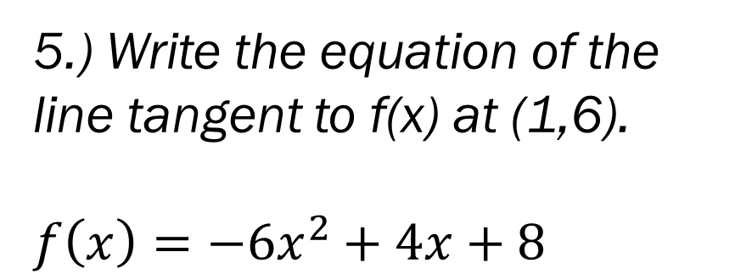
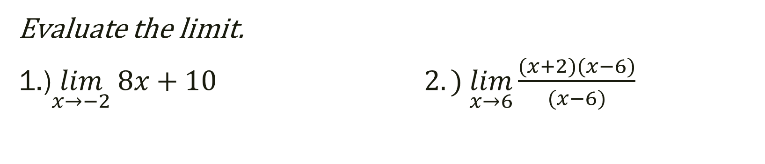
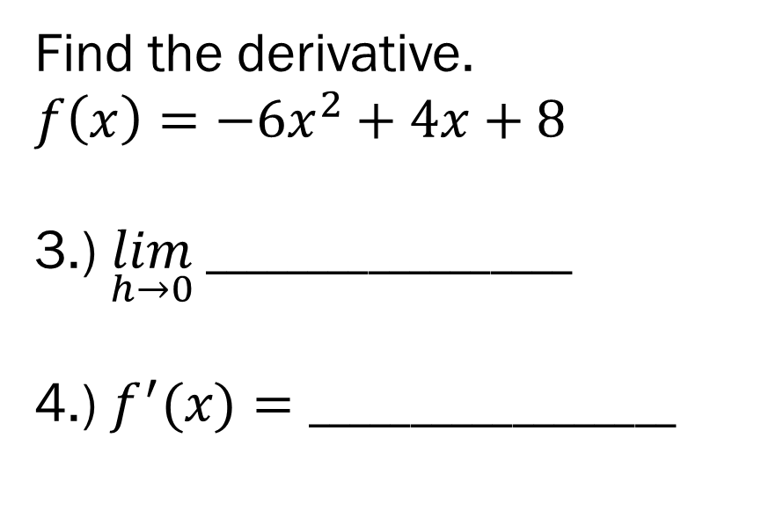
Unit 11 Quiz 1
Evaluate the limit.
1.)$\lim_{x→−2} 8x+10 2.) \lim_{x→6}\frac{(x+2)(x−6)}{(x−6)}$
Find the derivative.
$$f\left(x\right)={−6x}^{2}+4x+8$$
3.) $\lim_{h→0} __________________$
4.) $f^{′}(x)=__________________$
5.) Write the equation of the line tangent to f(x) at (1,6).
$$f\left(x\right)={−6x}^{2}+4x+8$$

Slide 4
From Last Time
Page 878 #8, 43, 59, 71

Slide 5
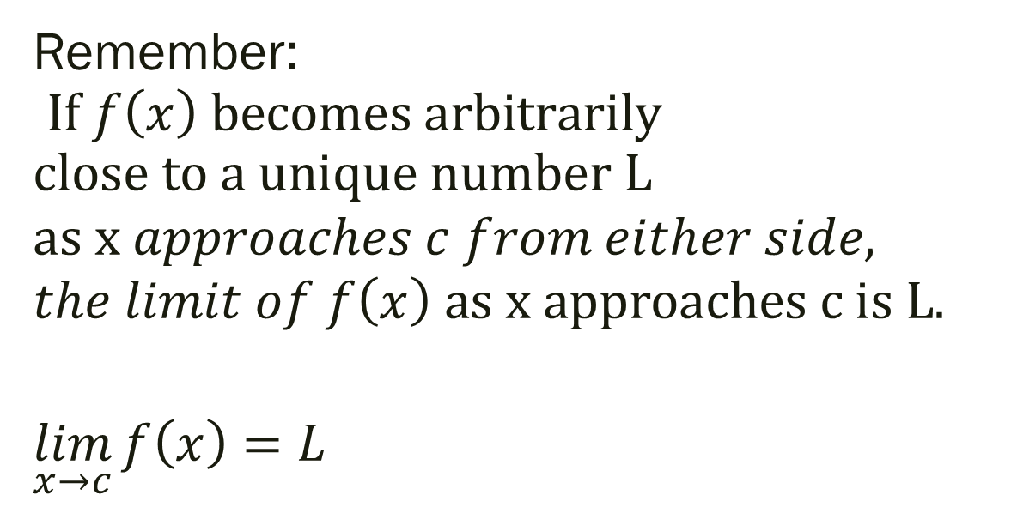
12.4 Limits at Infinity
Remember: $If f\left(x\right) becomes arbitrarily$ $$close to a unique number L$$
$$as x approaches c from either side,$$
$$the limit of f\left(x\right) as x approaches c is L.$$
$$\lim_{x→c}{f\left(x\right)=L}$$

Slide 6
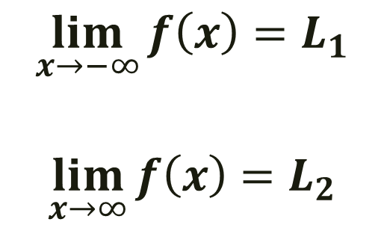
Definition of Limits at Infinity
$$\lim_{x→−∞}{f\left(x\right)=L_{1}}$$
$$\lim_{x→∞}{f\left(x\right)=L_{2}}$$

Slide 7
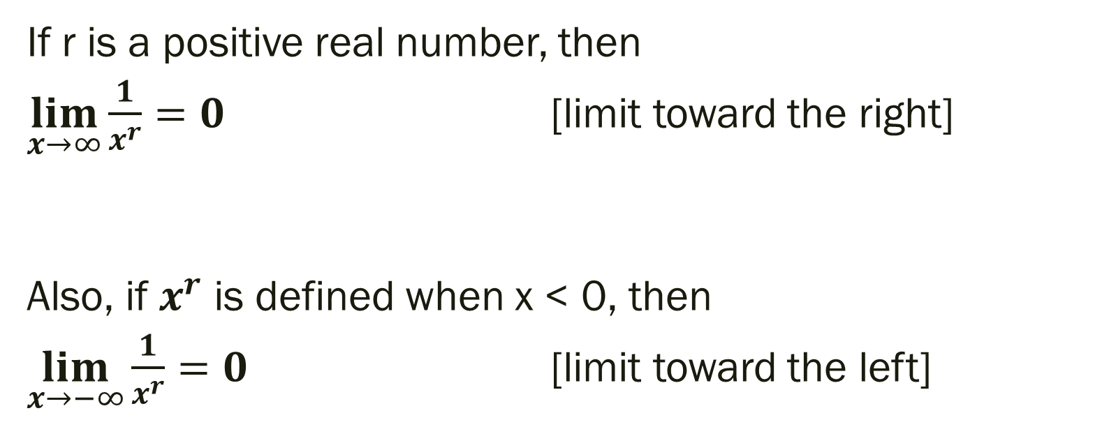
Limits at Infinity
If r is a positive real number, then
$\lim_{x→∞}{\frac{1}{x^{r}}=0}$ [limit toward the right]
Also, if $x^{r}$ is defined when x < 0, then
$\lim_{x→−∞}{\frac{1}{x^{r}}=0}$ [limit toward the left]

Slide 8

Example: Find the limit
$\lim_{x→∞}{(8−\frac{5}{x^{2}})}$

Slide 9

Example
Find the limit
$\lim_{x→∞}{(8−\frac{5}{x^{2}})} →\lim_{x→∞}8−\left(\lim_{x→∞}\frac{5}{x^{2}}\right)→\lim_{x→∞}8−5(\lim_{x→∞}\frac{1}{x^{2}})$
$$8−5\left(0\right)$$
$$\lim_{x→∞}{(8−\frac{5}{x^{2}})}=8$$

Slide 10
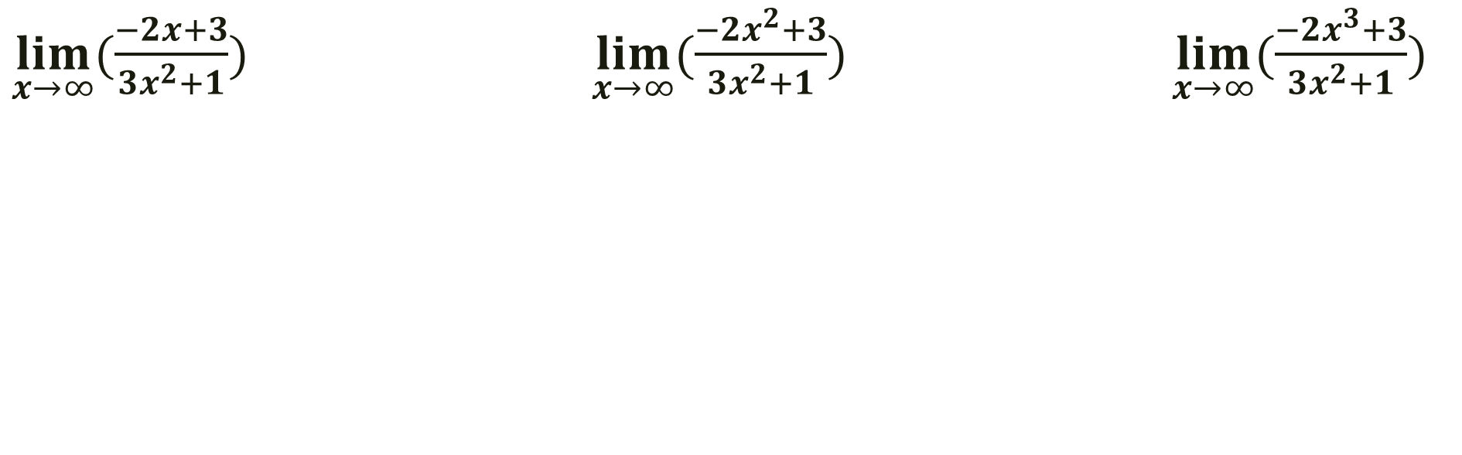
Example: Find the limit [Hint: Divide everything by the highest powered term in denominator]
$\lim_{x→∞}{(\frac{−2x+3}{{3x}^{2}+1})}$ $\lim_{x→∞}{(\frac{{−2x}^{2}+3}{{3x}^{2}+1})}$ $\lim_{x→∞}{(\frac{{−2x}^{3}+3}{{3x}^{2}+1})}$

Slide 11
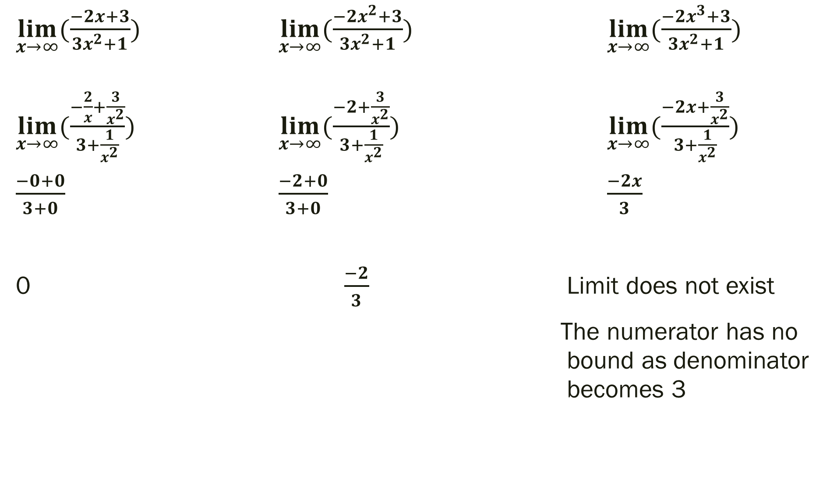
$\lim_{x→∞}{(\frac{−2x+3}{{3x}^{2}+1})}$ $\lim_{x→∞}{(\frac{{−2x}^{2}+3}{{3x}^{2}+1})}$ $\lim_{x→∞}{(\frac{{−2x}^{3}+3}{{3x}^{2}+1})}$
$\lim_{x→∞}{(\frac{−\frac{2}{x}+\frac{3}{x^{2}}}{3+\frac{1}{x^{2}}})}$ $\lim_{x→∞}{(\frac{−2+\frac{3}{x^{2}}}{3+\frac{1}{x^{2}}})}$ $\lim_{x→∞}{(\frac{−2x+\frac{3}{x^{2}}}{3+\frac{1}{x^{2}}})}$
$\frac{−0+0}{3+0}$ $\frac{−2+0}{3+0}$ $\frac{−2x}{3}$
0 $\frac{−2}{3}$ Limit does not exist
The numerator has no bound as denominator becomes 3

Slide 12
For Next Time
Page 887 # 9, 13, 17, 23

